Slide 1
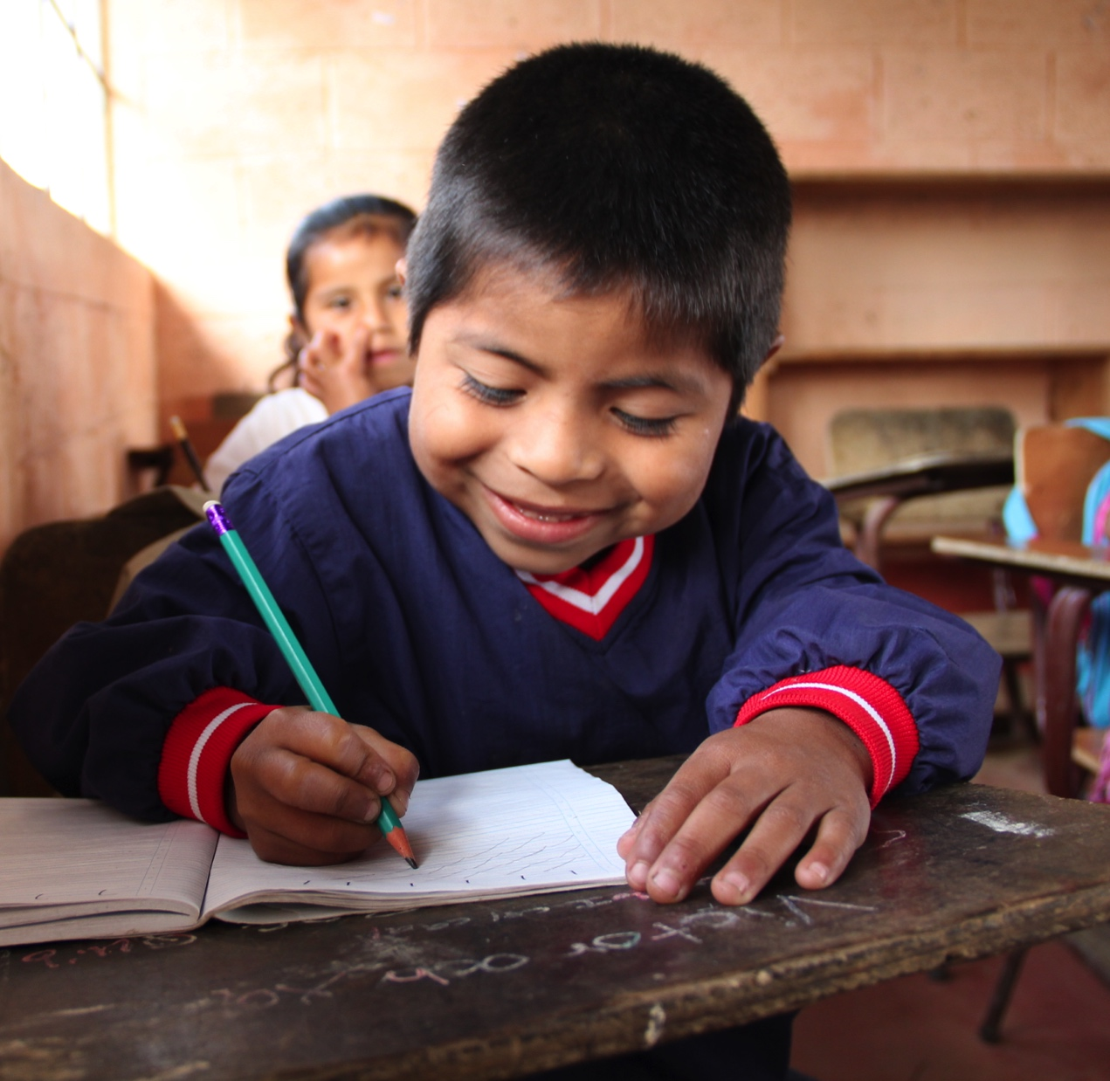

CLOSING
GAPS

Slide 2

BACKGROUND
In Ecuador, like other countries in Latin America and the Caribbean, coverage for primary education is not the main concern anymore (or was before the COVID-19 pandemic).
The main concern, are the low levels of learning once students are enrolled and attending.
Several studies, inside and outside of the region, have established that inside the schools, teachers are the main determinants of learning. Chetty et al. (2014), Staiger y Rockoff (2011), BID (2018).
Establishing a causal effect of teachers on student’s learning is not easy since children are not randomly assigned to their teachers.
Closing Gaps has accomplished the randomization of this assignment for 8 years, which allows to answer several questions regarding the quality of learning in schools in Ecuador.
Closing Gaps has allowed us to identify which characteristics make a good teacher (behaviors and practices) and therefore, where to act in terms of policy.

Slide 3
THE STUDY
Approximately 200 schools where randomly selected from the Costa regime, which includes 14 provinces of Ecuador.
This compiles more tan 20,000 students, around 2,500 teachers
The study has been running for around 9 years
  Compiling a balanced panel that observes more than 9,000 children who have remained in the study for all 9 years.
The information on the students, and their families, and schools collected by the project has been merged with administrative data from the Ministry of Education in Ecuador to get more information on variables such as:
  Attendance, dropouts, etc.
  Teacher’s experience
  Grades for other schools in the country

Slide 4


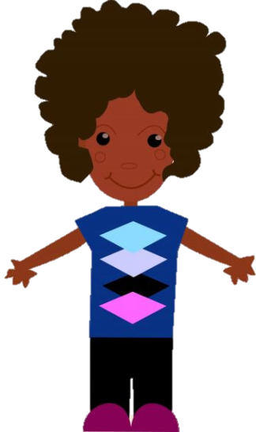
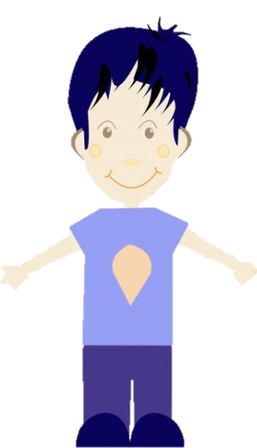
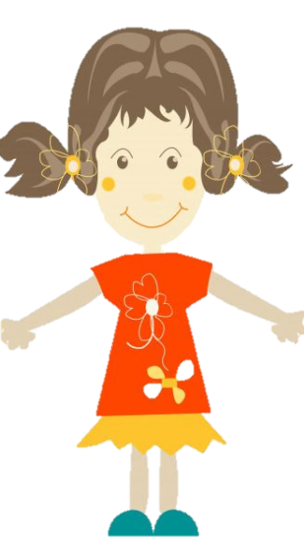
RANDOMIZATION PROCESS
1. We took the list of ALL children in, for instance, 1EGB and randomly assign them a number from 1 to the total of children in each school.
1
5
4
2
3

Slide 5
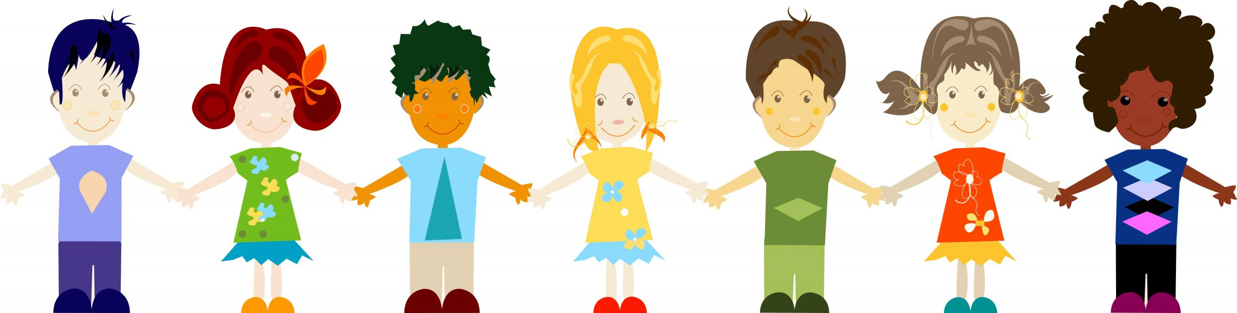
RANDOMIZATION PROCESS
2. We order the children from lowest to highest according to their assigned number.
3. The first child goes to classroom A, the second to classroom B and so on, the third to classroom C and so on.
1 2 3 4 5
A
B
C
A
B

Slide 6
DATA COLLECTION
For years 1EGB to 7EGB we:
1. Randomly assigned students to their teacher’s (classroom) at the beginning of the school year.
2. Observed interactions between teacher’s and students (CLASS recordings) (1EGB-5EGB)
3. Measured children’s:
  Development in math, language and executive function skills using standardized tests.
  Behavioral issues as observed by the teacher
  Who they are friends with as observed by the teacher
  4. Teachers’ characteristics.
In years 1EGB and 7EGB
  We also collected information on the children’s socio-demographic variables.
  In 7EGB:
  We also collected non-cognitive information of the children such as: measures of depression and growth mindset.

Slide 7
RESEARCH AND RESULTS
Teachers behaviors do have an impact on children's learning.
A year with a good teacher reduces the cognitive gap between students with mothers who have completed primary school and completed secondary school by half.
  Having a good teacher is equivalent to improving the educational level of the mother.
Good practices are comprehensive:
  A good teacher improves learning in all areas, and it improves learning for all the students in the classroom.
  The effect of good practices lasts over time and accumulates teacher to teacher.
Published articles:
1. Mothers, teachers, peers, and the gender gap in early math achievement (Carneiro, Cruz-Aguayo and Schady, 2018)
Finds steep socioeconomic gradients and a substantial boy-girl gap in math test scores.
2. Teacher quality and learning outcomes in kindergarten (Araujo, Carneiro, Cruz-Aguayo and Schady, 2016)
A one-standard deviation increase in classroom quality results in 0.11, 0.11, and 0.07 standard deviation higher test scores in language, math, and EF, respectively.
Teacher behaviors, as measured by the CLASS, are associated with higher test scores.
Parents recognize better teachers, but do not change their behaviors appreciably to take account of differences in teacher quality.

Slide 8
SOME POLICY IMPLICATIONS
Policies for teacher’s assignment to schools
  Effective teachers have the greatest impacts in Kindergarten, so the best ones should be assigned at that level.
  Effective teachers also have the greatest impacts in children with lower levels of achievement, so the best ones should be assigned to schools with particularly low levels of achievement.
Policies for evaluation and promotion of teacher’s within schools
  Evaluate teachers according to their behaviors within the classroom.

