Slide 1
Longitudinal population studies: opportunities and challenges Rebecca Hardy CLOSER Director
Learning from longitudinal studies in LMIC countries: before, during and after COVID-19
13th May 2021

Slide 2
CLOSER partner studies

Slide 3
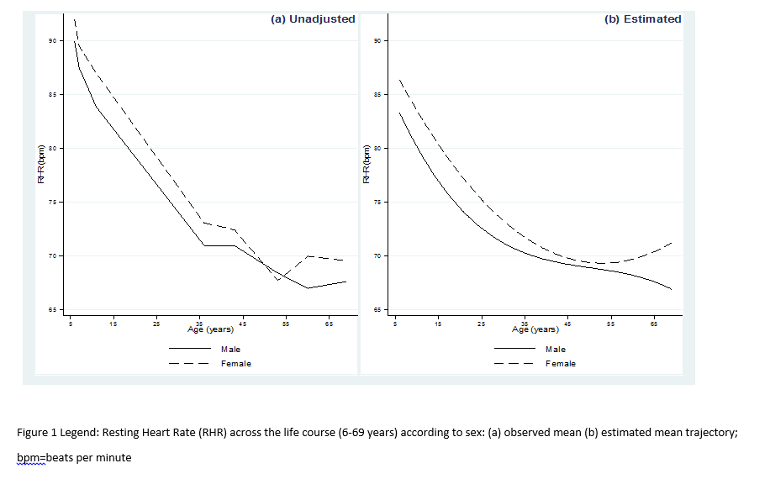
Making the most of longitudinal data
Repeated measures across the life course to track change
Give voice to different generations and understand the varying social contexts in which people live
Life course trajectory
Life course
determinants
Later life health
outcomes
O’Hare et al. JAMA Peds 2018

Slide 4
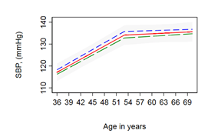
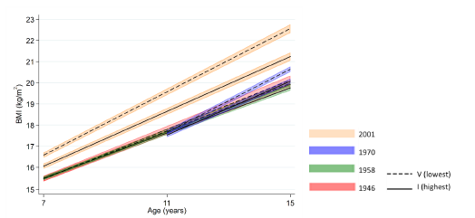
Making the most of longitudinal data
O’Keeffe et al. Heart 2020
Bann et al. Lancet Public Health 2018
Impact of health or social events
Health diagnosis and treatment
Menopause
Retirement
COVID-19
Differences by time and place
Across generations
Across regions
Across countries

Slide 5
Challenges
COVID-19 pandemic accelerated trends towards:
Remote data collection
Data linkage
Harmonisation of measures within (as well as between) studies
Planning and timing of data collections
Participant (and public) engagement
Training and capacity building of the next generation of study staff and researchers
Impact

